Slide 1
SALEM: Service Fairness in Wireless Mesh Environments
Henrique Silva,
Professor Bruno Sousa,
Noé Godinho
DEI
01st July 2022
Notes:
Good morning everyone
My name is Henrique Silva I am master student at the Department of Informatics and Eng
Today i am here to present SALEM (mechanism/project) that myself, professor Bruno Sousa and PHD student Noe Godinho have been working on

Slide 2
Contents
Motivation
SALEM
Formulation & Heuristic
Implementation & Topology Emulation
Experimental Setup & Evaluation
Notes:
RAPIDO
I will go over some of the topics we will cover
1) the motivations that fueled this work
2) what constitutes SALEM
3) how we are considering fairness
4) Implementation and emulation choices + display some issues that we faced
5) Describe the experimental Setup AND Evaluation steps to test the effectiveness of SALEM

Slide 3
Motivation
Heterogeneity of services and requirements - Migration of services to the cloud and emerging new use cases changed what network need to comply/handle.
Wireless Mesh Networks (WSN) can help but there is still a need to manage resource, nodes usage intelligently fairly
Limited mechanisms - Go beyond the traditional equal distribution of resources to manage services & Start taking advantage of the SDN paradigm
Limitations of Openflow (OF) - Research and develop a mechanism to work around the limitations of OF in wireless scenarios (e.g. wireless channel selection, interference, mitigation, mobility management)
Aveiro Tech City Living Lab (ATCLL) - Take advantage of our prior knowledge of the ATCLL
Notes:
Due To migration of a lot of services to the cloud , we now have more network traffic; heavier loads; (new emerging UC) different new technologies in networks; battery powred devices;mesh connections (enhance the reliability, scalability)
>All this requires managing resources and node usage as intelligently and in the most fair way possible
2) Fairness is commonly viewed as “equal distribution of resources” (e.g using Traditional Load Balancing), but this normally doesn’t translate well into real scenarios (it has its limits);
We are now seeing more diverse and specialised classifications for fairness such as: per-flow fairness, per-link fairness, per node fairness that consider different objectives (defenittly the rigth direction)
found related work that “handicaps it self” by not taking advantage of the SDN paradigm ( information in the controller, birds-eye-view of tyh topology)
[ex: mech tradicionais de Load Balance ]
3) OF : It is a standard of SDN BUT It can’t assure additional features required in networks with wireless connections.
Try to work around that
4) infrasctucture in city of Aveiro (different devices, technologies, services) at the disposal of developers and researchers.
>could be a good base line to test ur mechanism against OR repesent what a real smart city scenario looks like

Slide 4
SALEM Objective
An approach to support fairness in Wireless Mesh Networks (WSN) with heterogeneous technologies and computational settings, and managed through SDN controllers
Introduces a fairness model taking into account three objectives to address the routing issue in WSN: fairness of delay, fairness of reliability and fairness of energy
Business logic implemented as an ONOS controller application
Tested against ATCLL and similar smart-citie scenarios
Notes:
as a result-> salem a fairness mechanism to apply in SDN compliant environments & with wireless mesh connections & that targets smart cities environments (like ATCLL).
2)
3)take advantage of the nature of the SDN controller to (collect information, manipulate devices)
4)Take inspiration on the ATCLL

Slide 5
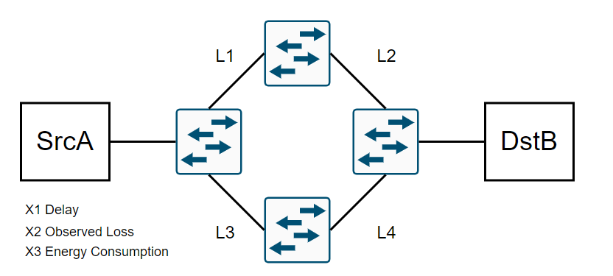
Fairness Optimization
SALEM includes a Mixed Integer Linear Programming (MILP) formulation to determine the optimal sets as a tri-objective multicommodity problem, where each service corresponds to a commodity and each link has a capacity (bandwidth) constraint
Notes:
Fairness Model
won’t go into more detail:
>formulation (Lab setting) + heuristic (real-time)
>heuristic is implemented in ONOS (gives us the path for the service)
>Formulation is modeled as a multi-comodity-flow with 3 objectives (energy consumption , delay, observed loss) and uses a min-max technique to obtain trade-off solution
>Heuristica: heuristic works as a single-path min-cost-flow algorithm; We normalize the values of each metric to be comparable and, for each link, we set as weight of the link with highest metric value
The the heuristic gives

Slide 6
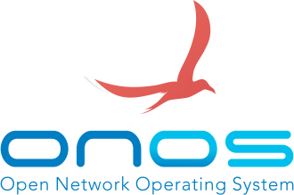
Implementation
Built on-top of the ONOS controller
Uses the JGraphT Java library
CapacityScalingMinimumCostFlow
Collects information of the topology (e.g. layout, loss, flows)
Detects a new flow (corresponding to a new service)
Runs the heuristic
Installs flow rules accordingly
Test against emulated scenarios [Mininet/Mininet Wifi]
Notes:
>JgraphT, to avoid to build the heuristic logic from the ground up;
>Test against emulated scenarios of smart cities in Mininet (took inspiration of the ATCLL)
>Initially with mn Wifi-> got some issues (that we cover in the next slides)-> reverted back to mn [As a way to have a topology with deterministic behaviour]
FALR QUE USAMOS O mn wf-> DEU PROBM -> VOLTAMSO PARA O MN

Slide 7
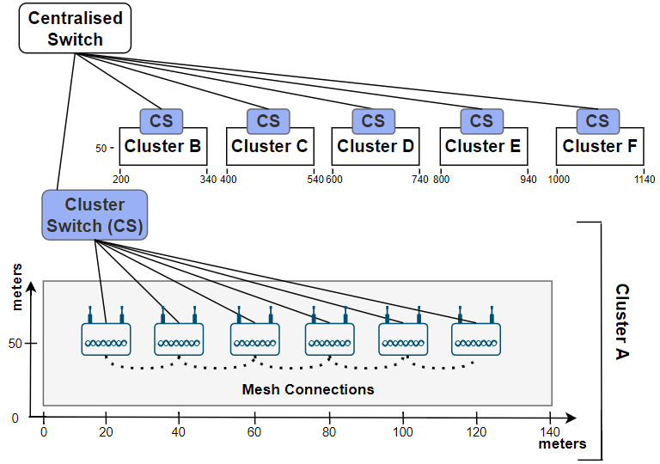
Topology Emulation - Mininet Wifi
Using Mininet-Wifi
A centralised backbone SDN switch, Openflow capable
6 clusters of devices with 6 AP each (36 total APs)
Each cluster has a SDN switch connecting APs
Each AP has wired connections with 10Gbps Fibber optics
Each AP has IEEE 802.11ax, 2.4GHz wireless connections
176 meter AP range (output of Friis link budget equation )
1
https://www.allaboutcircuits.com/technical-articles/wireless-range/
Notes:
Initial target scenario
explicar aproximar ao cenario de aveiro:
Base da topologia da aveiro-> vimos as zonas de cobertura, num do nodes, tecnologias, etc-> ficou assim no final
*METER A REF PARA A LINK EQ FOOTNOTE
A centralised backbone SDN switch, Openflow capable;
6 clusters of devices with 6 AP each (36 total APs);
Each cluster has a SDN switch connecting APs;
Each AP has wired connections with 10Gbps Fibber optics;
Each AP has IEEE 802.11ax, 2.4GHz wireless connections

Slide 8
Problems with Mininet Wifi
Wireless connections reporting unwanted losses in traffic simulations
Trouble parsing ARP requests in mesh environments;
Interference between access points
Opting to use wired links (with host or TCLink) cause mesh disconnection
Couldn’t trust the environment, it wasn’t deterministic
Result
Shift back to Mininet while simulating the conditions necessary to evaluate the fairness characteristics of the mechanism
Openflow enabled devices and hosts, adjustable link loss rates, bandwidth and delays, and flexible workload of traffic for different services
Notes:
> initially emulated through Mininet-WiFi However, the authors faced several obstacles with the Mininet-wifi emulator
[Wireless connections between stations and access points were reporting, unwanted, losses in traffic simulations; ONOS applications
had trouble parsing ARP requests in mesh environments; interference between access points caused wireless links to sporadically and temporally disconnect; using hosts to replace the stations made the wireless connections disconnect sporad- ically; using TClink class to get wired links between stations
and access points introduced new ARP handling problems that blocked traffic (stations had problems sending ARP replies through wired interfaces]
nao nos dava confiança no ambiente
nao conseguiamos ser determinísticos
problemas (nao relacionados com o modelo de fairness) que iam estragar os resultados comparativos

Slide 9
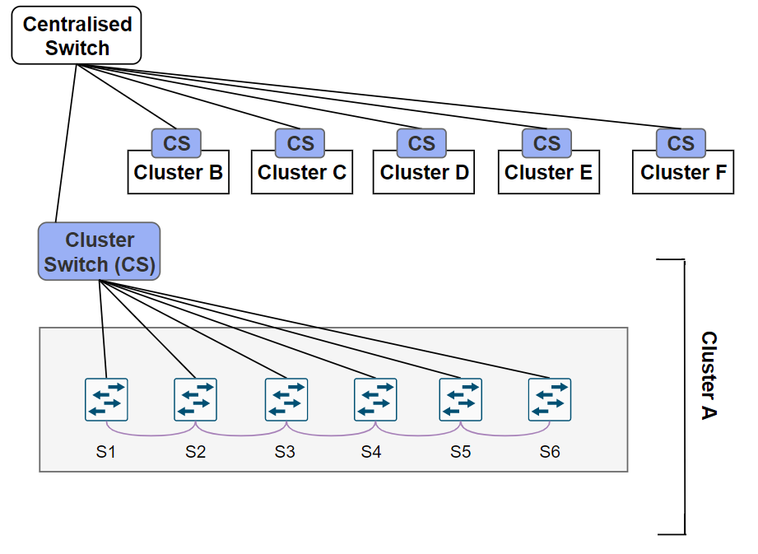
Topology Emulation - Mininet
Using Mininet
Replace APs with Switches
Replace Stations with Hosts
Uses the TCLink class
Has only wired connections
Switch to switch have 54Mbps and 1.2% loss
Switch to hosts have 54Mbps and lossless
Remaining links have 1Gbps and lossless
1
Moreira, M. J. (2020) yawmd: multiple medium support and performance improvements for wmediumd [Master’s thesis, FCUP]
Notes:
“This link class only support bandwidth up to 1Gbps, so some adjustments were necessary: links between hosts and switches, plus links between switches of the same cluster (the previous mesh connections), have bandwidth of 54Mbps, wich is theoretical
maximum for 802.11g [25]; the remaining links have bandwidth of 1Gbps, to have some bandwidth heterogeneity in the topology
”
CONFIGURAÇOES FORAM FEITAS ATRAVES DO TCLINK diretamente nos scripts do mininet
FOOTNOTE DA TESE PARA AS 1.2%

Slide 10
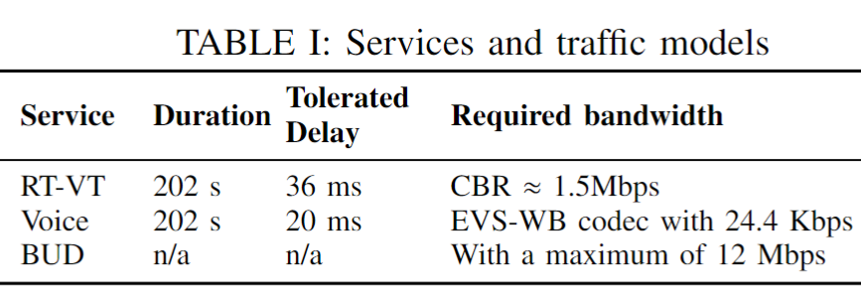
Experimental Setup & Evaluation
Communications inside the cluster (Intra)- formulation vs heuristic “how good the solution is”/”how close the solution is to the perfect scenario”
Communications between clusters (Inter)- record metrics and compare against off the shelf ONOS algorithms
Notes:
Intra: only to first validate the fairness mechanism in a simple scenario
Inter: TO se the effectiveness of the aproach;
>varios users, diferente % of services per host,
(video, voice, trafico web)
>using iperf
comparar o fair heuristic com o k-short em termos de fairness (utilização dos links, impacto no serviço [jitter, delay,...])
“Run K-Shortest Path of ONOS with link edges considering only energy cost
Compare this approach against ours in terms of delay, jitter, loss and throughput
Collect the link utilisation of each connection to assess if the load is being “fairly” distributed”
[K shortest path algorithm provides k shortest paths from a graph with network links, and
orders the results considering the configured link weights.]
>Don’t have any compiled results of the experiments yet (trying to push troght the issus of mn wifi cost us allot of time) [na fase de validar a heuristica com a formulação]

Slide 11
Questions?
Henrique Silva,
Professor Bruno Sousa,
Noé Godinho
01st July 2022

